Slide 1
Software Engineering Unit-II
Prepared by: Neha Tripathi

Slide 2
Requirement Engineering(RE) Process

Slide 3
Requirement Engineering
Requirements engineering (RE) refers to the process of defining, documenting, and maintaining requirements in the engineering design process.
Requirement engineering provides the appropriate mechanism to understand what the customer desires, analyzing the need, and assessing feasibility, negotiating a reasonable solution, specifying the solution clearly, validating the specifications and managing the requirements as they are transformed into a working system.
Thus, requirement engineering is the disciplined application of proven principles, methods, tools, and notation to describe a proposed system's intended behavior and its associated constraints.

Slide 4
Requirement Engineering Process
The requirements engineering process is an iterative process.
It is a four-step process, which includes -
- Feasibility Study
- Requirement Elicitation and Analysis
- Software Requirement Specification
- Software Requirement Validation
- Software Requirement Management

Slide 5
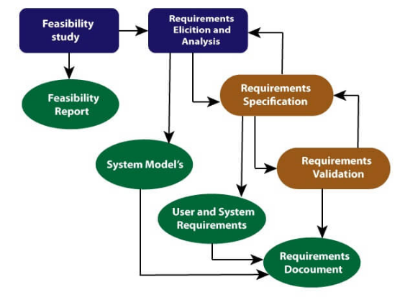
Requirement Engineering Process

Slide 6
Feasibility Study:
The objective behind the feasibility study is to create the reasons for developing the software that is acceptable to users, flexible to change and conformable to established standards.
Types of Feasibility:
Technical Feasibility - Technical feasibility evaluates the current technologies, which are needed to accomplish customer requirements within the time and budget.
Operational Feasibility - Operational feasibility assesses the range in which the required software performs a series of levels to solve business problems and customer requirements.
Economic Feasibility - Economic feasibility decides whether the necessary software can generate financial profits for an organization.

Slide 7
1.Requirements Elicitation and Analysis:
After an initial feasibility study, the next stage of the requirements engineering process is requirements elicitation and analysis.
This is also known as the gathering of requirements. Here, requirements are identified with the help of customers and existing systems processes, if available.
In this activity, software engineers work with customers and system end-users to find out about the application domain, what services the system should provide, the required performance of the system, hardware constraints, and so on.
Analysis of requirements starts with requirement elicitation. The requirements are analyzed to identify inconsistencies, ambiguities, redundancies, defects, omission, etc. We describe requirements in terms of relationships and also resolve conflicts if any.

Slide 8
2.Requirement Specification
The process of writing the user and system requirements in a requirements document known as Software requirement Specification(SRS) document.
This activity is used to produce formal software requirement models.
All the requirements including the functional as well as the non-functional requirements and the constraints are specified by these models in totality.
During specification, more knowledge about the problem may be required which can again trigger the elicitation process.
The models used at this stage include ER diagrams, data flow diagrams(DFDs), function decomposition diagrams(FDDs), data dictionaries, etc.

Slide 9
3. Requirement Validation
Validation: It refers to a different set of tasks that ensures that the software that has been built is traceable to customer requirements. If requirements are not validated, errors in the requirement definitions would propagate to the successive stages resulting in a lot of modification and rework. The main steps for this process include:
The requirements should be consistent with all the other requirements i.e no two requirements should conflict with each other.
The requirements should be complete in every sense.
The requirements should be practically achievable.
Reviews, buddy checks, making test cases, etc. are some of the methods used for this.

Slide 10
4. Requirement Management
Requirement management is the process of analyzing, documenting, tracking, prioritizing and agreeing on the requirement and controlling the communication to relevant stakeholders.
This stage takes care of the changing nature of requirements.
It should be ensured that the SRS is as modifiable as possible so as to incorporate changes in requirements specified by the end users at later stages too.
Being able to modify the software as per requirements in a systematic and controlled manner is an extremely important part of the requirements engineering process.

Slide 11
Thank You!

